Slide 1
Module 14 – Planning
Training Modules for Applying the Mitigation Hierarchy:
Planning Policy and Projects for No Net Loss or a Net Gain of Biodiversity
Module 14
Planning

Slide 2
Planning Module – Abstract
This training course is about planning to achieve Biodiversity Net Gain (or No Net Loss or similar goal) in the context of development. One of the principal ways of doing this at scale is planning at the national (or state) level, which is the topic of this module.
The module starts with an introduction: what is a national or state system for BNG/NNL and why can it help?
Next, it covers how to plan: what are the key issues, the basic features of BNG/NNL plans and key elements of a strategy.
The next section helps governments (and their stakeholders) to establish how strong the national (or state) system for BNG/NNL is, explaining the criteria for benchmarking these systems.
Countries will have some law, policy, guidelines and organisations already involved in the mitigation hierarchy. Before introducing new policy and institutions, it helps to establish the gaps between what’s already available and what’s needed. The module describes gap analyses that can be undertaken on policy, capacity and data in order to review the country’s starting point for BNG/NNL planning.
Finally, the Module summarises the planning for BNG/NNL in the four COMBO countries and links to a Module with example from Victoria, Australia and another Module describing a Government Roadmap to help plan for BNG/NNL.

Slide 3
Module on Planning – Contents
Contents | Slides
Introduction: How to plan for Biodiversity Net Gain or No Net Loss – national and project level; What is a national or state system for BNG/NNL and why can it help? | 4-10
How to plan: Key issues, basic features of BNG/NNL plans and key elements of a strategy | 11-14
How good is your national or state system for BNG/NNL? Criteria in a benchmark for national systems. | 15-17
BNG system gap analyses: policy, capacity and data | 18-22
Take home messages | 23
BNG/NNL planning in the COMBO countries – national systems | See Module 15
System example from Victoria, Australia | See Module 16

Slide 4
Planning
Introduction

Slide 5
No Net Loss and Biodiversity Net Gain: How to plan?
Planning for NNL/BNG can take place at two levels:
NATIONAL planning: establishing a national policy and system for NNL/BNG
What are the key issues and elements of a national system for ‘Biodiversity Net Gain’, ‘No Net Loss’ or a similar goal?
PROJECT planning: designing and implementing a development project (e.g. mine, windfarm, harbour development, plantation) for NNL/BNG.
What are the key issues and approaches for designing a specific project for ‘Biodiversity Net Gain’ or ‘No Net Loss’?
Notes:
Simply stated, Biodiversity Net Gain (BNG), also sometimes described as Net Positive Impact (NPI), means leaving biodiversity better off following development activity, compared with a clear reference scenario

Slide 6
What is a national (or state) system for BNG/NNL?
A national (or state) system for BNG/NNL involves the law, policy, the scientific and technical guidelines, data and advice, and the system of governance that implements the policy effectively (including coordination between agencies and participation of a variety of stakeholders). A component of capacity building and training is advisable.
A BNG system will need institutions and tools to help developers apply the mitigation hierarchy, concentrate on effective avoidance measures and find and secure for the long term any biodiversity offsets they may need.
The system can build on suitable elements that may already exist in the country concerned, but where there are gaps, mechanisms will need to be established, and this will take a period of years.
Notes:
Simply stated, Biodiversity Net Gain (BNG), also sometimes described as Net Positive Impact (NPI), means leaving biodiversity better off following development activity, compared with a clear reference scenario

Slide 7
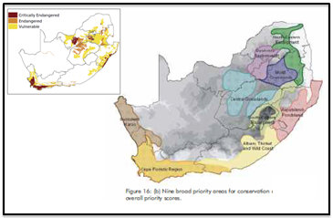
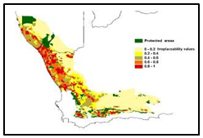
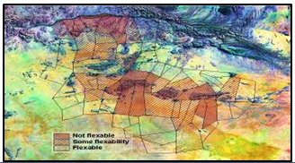
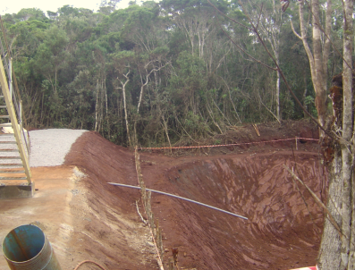
Planning context for offsets and compensation
National Conservation and Development Planning & Prioritization
Policy framework for land-use, impact assessment, mitigation including offsets.
Align MH incl. offsets with biodiversity conservation goals
Strategic Environmental Assessment - Regional
Land Use Planning
Landscape level assessment of suitable areas for development, protection, or restoration (offset site selection). Location of dev projects, aggregated offsets, conservation banks.
Single Project EIA
Single Project EIA
Single Project EIA
Project by project impact assessment and offset planning and design
Detailed mitigation hierarchy for project and offset design.
National level
Regional level
Landscape level
Site level
Notes:
To put into context any individual project, or set of projects with potential impacts on the environment, and in particular on biodiversity it is enormously helpful to have to hand information on what is happening at a landscape level. This information will usually be the result of biodiversity assessment and planning that has been done at various scales – from the national level to the regional and landscape level. It’s ideal if these different planning processes and scales are integrated, nested and inform each other. Coarser level information, including spatial planning at the national/regional or landscape level planning can interact with SEA and similar processes and informs site level decisions and processes for individual projects.
How this kind of broad-scale planning interacts with and influences the design of mitigation measures for individual projects is shown in the boxes on the RHS. At the highest level, the relevant policy framework on land use, impact assessment and offsetting will enable offsets to be aligned with biodiversity conservation goals at the national (or State) level.
Landscape level assessment of suitable areas for development, protection, or restoration (offset site selection) can inform where to place ‘offset receiving areas’, including the location of aggregated offsets and conservation banks. Alongside national level planning, it will also guide where development should be avoided – i.e. high level application of the mitigation hierarchy!

Slide 8
Planning a national system for BNG/NNL: introduction
What are the key issues and elements of a national system for ‘Biodiversity Net Gain’, ‘No Net Loss’ or a similar goal?
Key issues: principal elements and key stages of planning a system for Biodiversity Net Gain
Benchmarking performance
Definitions, examples and further information
What is needed to make a real shift towards Biodiversity Net Gain?
Roles and responsibilities of different actors.

Slide 9
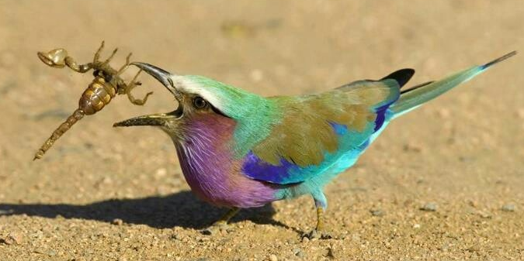
Planning a national system for BNG/NNL: Key issues
What are the key issues and elements of a national system for ‘Biodiversity Net Gain’, ‘No Net Loss’ or a similar goal?
What is a national (or regional) system for ‘Net Gain of biodiversity’ and why can it help?
How does Biodiversity Net Gain planning relate to sustainable development goals and biodiversity targets?
What are the opportunities and risks in planning for Biodiversity Net Gain?
What are the options for policy goals (e.g. Biodiversity Net Gain, No Net Loss and alternatives)?
What are the principal elements of a system for Biodiversity Net Gain?
Why a ‘roadmap’? What are the key stages of planning for BNG/NNL?
What are some key lessons learned from past experience?

Slide 10
Some basic features of NNL/NG systems
Landscape level planning & site selection
Mitigation hierarchy:
Avoidance: alternatives analyses; No Go; Non-offsetable; avoidance measures
Minimisation: avoiding the ‘Mitigation Myth’
Restoration/rehabilitation on-site: repair ecosystem processes & services
Biodiversity offsets: measurable conservation outcomes tackling residual impacts (after avoidance, minimisation, resto/rehab) to achieve NNL/NG.
Free Prior and Informed Consent: A right and process. A mutually accepted process & evidence of agreement are documented after a good faith negotiation between a developer and affected communities.
Metrics (‘HOW MUCH BIODIVERSITY?’): the measures of how much biodiversity is lost, gained or exchanged.
Exchange rules (‘WHICH BIODIVERSITY?’): which losses can be exchanged for which gains? ‘Like-for-like or better’, allowing ‘trading up’.
….. Establishing these takes land-use planning, law, policy, biodiversity data, mapping and human and institutional capacity
Notes:
Landscape level planning & site selection: to guide alternatives analyses, impact assessment, mitigation design and siting of development activities and conservation activities
Mitigation hierarchy:
Avoidance: alternatives analyses; No Go option and criteria; Non-offsetable impacts & limits; avoidance measures for particular projects
Minimisation: realistic planning, equipment and management to reduce impacts on biodiversity (avoiding the ‘Mitigation Myth’)
Restoration/rehabilitation on-site: measures to repair ecosystem processes, productivity & services, and sometimes to re-establish species composition &community structure in areas affected by development.
Biodiversity offsets: measurable conservation outcomes tackling residual impacts (after avoidance, minimisation, resto/rehab) to achieve NNL/NG.
FPIC: A right and process, where a project affects the lives, livelihoods, lands and territories of indigenous peoples, sometimes extended to local communities. A good faith negotiation between a developer and affected communities in which a mutually accepted process & evidence of agreement are documented. See IFC Performance Standard 7.
Metrics: the measures of how much biodiversity is lost, gained or exchanged, such as measures combining area x condition and measures for particular species’ populations.
Exchange rules: defining which components of biodiversity can & cannot be substituted for others in a biodiversity offset. Often ‘like-for-like or better’, allowing ‘trading up’.
….. Establishing these takes land-use planning, law, policy, biodiversity data, mapping and human and institutional capacity

Slide 11
Planning
How to plan

Slide 12
Planning a national system for BNG/NNL: Key issues
What are the key issues and elements of a national system for ‘Biodiversity Net Gain’, ‘No Net Loss’ or a similar goal?
What is a national (or regional) system for ‘Net Gain of biodiversity’ and why can it help?
How does Biodiversity Net Gain planning relate to sustainable development goals and biodiversity targets?
What are the opportunities and risks in planning for Biodiversity Net Gain?
What are the options for policy goals (e.g. Biodiversity Net Gain, No Net Loss and alternatives?
What are the principal elements of a system for Biodiversity Net Gain?
Why a ‘roadmap’? What are the key stages of planning for BNG/NNL?
What are some key lessons learned from past experience?
Do sep slides for these with some headline points under each

Slide 13
Basic features of NNL/NG systems
Context: Background & rationale; reference to existing relevant policies and laws.
Policy commitments:
Goal, e.g. NNL/NG of biodiversity (of what and relative to what)
Principles
Other commitments e.g. exchange rules, metrics and additionality.
Existing commitments, e.g. compliance with law on EIA, planning, protected areas, FPIC, etc.
Authority: mandatory/voluntary and (if former) how established in law
Governance arrangements: coordination, participation, oversight
Mechanisms & tools, e.g. conservation covenants; trust funds
Institutions, e.g. NNL Unit; inter-departmental committee for coordinated land-use planning.
Policy
Legal basis
Guidelines
Standards
Institutional framework
Notes:
Policy: Policy statement, often with reference to a set of principles, and explanation of how government will put this into practice:
Context: Background & rationale; reference to existing relevant policies and laws.
Policy commitments:
Clarify goal, for instance NNL/NG of biodiversity
Other specific commitments to aspects of the mechanism e.g. exchange rules and additionality.
Can set out existing commitments in related areas, e.g. compliance with law on EIA, planning, protected areas, FPIC, etc.
Authority: The policy should clarify whether it is mandatory or voluntary and (if the former) how it is established in law
Legal basis: Law and regulations giving effect to the policy (when needed);
Guidelines on how to apply the policy, including process and content;
Standards for government and those affected by the policy; and
Institutional framework: to put the policy into effect:
Governance arrangements
Mechanisms & tools, e.g. conservation covenants; trust funds
Institutions, e.g. NNL Unit; inter-departmental committee for coordinated land-use planning.

Slide 14
Elements of a NNL/Offsets strategy
Economic impact analyses of policy options
Policy/regulation
Policy/guidance
Principles and standards
Land-use planning and the broader context
Biodiversity planning
Supply side
Biodiversity data and maps
Pilot projects
Implementation
Training and capacity building
Legal and financial instruments to secure long-term implementation
Monitoring and enforcement
Evidence on the effectiveness of NNL/NG schemes
Roadmap and adaptive learning

Slide 15
Planning
Benchmarking: How good is your national/state system?

Slide 16
How good is your national/state system for BNG?
How to review the quality and performance of a national system for BNG/NNL?
Use a ‘benchmark’ of criteria to assess a particular government’s system for mitigation or compare different governments’ performance.
The BBOP benchmark allows the user to assess a particular policy and system of governance to mitigate the impacts of development projects on biodiversity - at the national, state or local government level.
The framework for review is a set of criteria describing particular aspects of policy. For each criterion, indicative descriptions have been provided to indicate what would constitute ‘low’, ‘medium’ and ‘high’ standards, allowing individual policies to be benchmarked against best practice.

Slide 17
Criteria in a benchmark of a national system for BNG/NNL
PROCESS
Process of development of policy:
Participatory
Roadmap
2
Process of implementation of policy, e.g.:
Stakeholder involvement, FPIC, independent review
Clarity, transparency, M&E of policy, enforcement
CONTENT
Goal
Scope
Mitigation hierarchy
Baselines, counterfactuals, additionality and gain
Limits to what can be offset
Exchange rules clear
Metrics clear
Information systems
Socioeconomic aspects clear
Implementation clear

Slide 18
Planning
Gap analysis

Slide 19
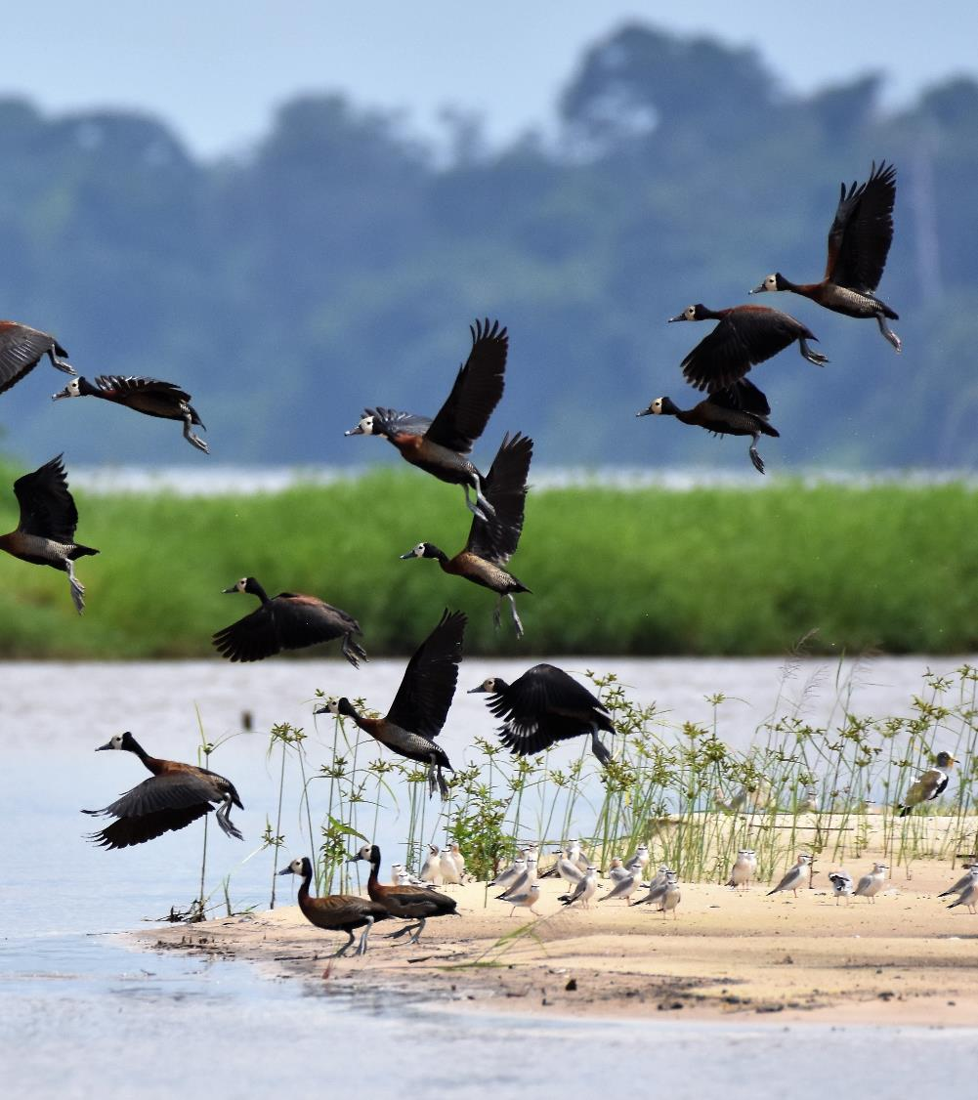
Which elements of a BNG system do you already have?
Gap analyses in three principal areas can help determine the readiness of a country to establish and implement a system for NNL/NG of biodiversity (or an alternative goal):
Law and policy
Capacity and experience
Information (data and maps)
….See BBOP Government Roadmap for suggested contents
Notes:
See Technical Note 12 in the Government Roadmap – on gap analyses

Slide 20
Policy and capacity gap analysis
We aimed to answer these questions under two main themes:
Policy and law gap analysis
What is the present policy and law on biodiversity outcomes?
How does it consider NNL/NG goals and application of mitigation hierarchy?
Does the law require, facilitate, say nothing or act as a barrier?
Capacity and experience gap analysis
Are there enough government staff to apply policy?
What is civil society capacity to support analysis and implementation of mitigation?
Do industry and consultants have necessary skills and knowledge?
Understanding these questions will aid focus on priorities for building national capacity to improve biodiversity outcomes.

Slide 21
Data gap analysis: data prioritisation - example
Theme | IFC and/or other significance criteria | Importance / Difficulty to find* | Potential global sources | Potential national sources
Terrestrial ecosystems | Good to help with accounting gains and losses. | High/Hard | http://www.intactforests.org. | Check Ministry/ Department of Environment and resource management agencies
Marine ecosystems | Many might meet IFC natural habitat if not modified. Rare or threatened ecosystems can be IFC critical habitat. If threatened can be KBA. | Very High/Easy | WCMC http://data.unep-wcmc.org | Check Ministry/ Department of Environment and resource management agencies including fisheries.
Aquatic ecosystems | Could be IFC natural habitat, could also be critical habitat if containing migratory and congregatory species. | High/Easy | Check for RAMSAR site http://ramsar.wetlands.org/Database/AbouttheRamsarSitesDatabase/tabid/812/D efault.aspx.
Species | IFC critical habitat. KBA criteria. HCV 1. | Very High/Hard | For species www.iucnredlist.org. www.keybiodiversityareas.org Key Biodiversity Areas. AZE sites here http://www.zeroextinction.org. | National Red List

Slide 22
Data gap analysis
Example from Madagascar:
Attribut | Nom | Étendue des données | Lien ou contact
Couverture forestière | Couverture mondiale | Mondiale | https://earth.esa.int/web/guest/-/globcover-v22-land-cover-product-now-available-5999
Végétation de Madagascar | Atlas de la Végétation de Madagascar | National | http://www.vegmad.org/downloads/laborde/veg_grid.zip
Déforestation globale | Changement forestier | Global | http://gis-gfw.wri.org/arcgis/rest/services/forest_change/MapServer/3
Intégrité ou condition de l’écosystème | Paysage forestier intact | Global | http://www.intactforests.org/data.ifl.html
Intégrité ou condition de l’écosystème | Carte de l’évolution de la déforestation (1953-2014) | National | bioscenemada.cirad.fr/maps

Slide 23
Module on Planning – Take home messages
In order to reach Biodiversity Net Gain (or No Net Loss or similar goal) at scale, and not just for individual projects, it is important to plan at the national or state level.
A national (or state) system for BNG/NNL involves the law, policy, the scientific and technical guidelines, data and advice, and the system of governance that implements the policy effectively (including coordination between agencies and participation of a variety of stakeholders). A component of capacity building and training is advisable.
A BNG system will need institutions and tools to help developers apply the mitigation hierarchy, concentrate on effective avoidance measures and find and secure for the long term any biodiversity offsets they may need. The system can build on suitable elements that may already exist in the country concerned, but where there are gaps, mechanisms will need to be established, and this will take a period of years.
Countries will have some law, policy, guidelines and organisations already involved in applying the mitigation hierarchy. Before introducing new policy and institutions, gap analyses on law & policy, human and institutional capacity, and data are useful to figure out the country’s starting point for BNG/NNL planning and what needs to be done.
Governments working to improve their national/state systems on mitigation and planning for BNG/NNL can use a ‘benchmark’ of criteria to assess the strength of their system for mitigation (e.g. improvements over time) or to compare themselves against other governments’ performance.
Examples show how planning for BNG can develop over a period of years. (Also, please see the Module on the Roadmap for Governments.)

